Slide 1



State-of-the-Art Open-Source Speech-to-Text Capabilities
Sanjeev Khudanpur
Johns Hopkins University
Center for Language and Speech Processing
February 16, 2017

Slide 2






Co-PI’s, PhD Students and Sponsors
Prof. Daniel Povey
Dr. Jan Trmal
Pegah Ghahremani
Vimal Manohar
Vijayaditya Peddinti
Matthew Wiesner
Hainan Xu
Xiaohui Zhang

Slide 3

Kaldi: Legendary Ethiopian goat herder who discovered coffee
60+ Contributors
Icon from http://thumbs.gograph.com

Slide 4
Kaldi: Community of Researchers Cooperatively Advancing STT
C++ library, command-line tools, STT “recipes”
Freely available via GitHub (Apache 2.0 license)
Top STT performance in open benchmark tests
E.g. NIST OpenKWS (2014) and IARPA ASpIRE (2015)
Widely adopted in academia and industry
300+ citations in 2014 (based on Google scholar data)
400+ citations in 2015 (based on Google scholar data)
Used by several US and non-US companies
Main “trunk” maintained by Johns Hopkins
Forks contain specializations by JHU and others

Slide 5
Talk Outline: Staying Ahead in the STT Game
STT technology is advancing very rapidly
Amazon, Apple, Baidu, Facebook, Google, Microsoft
Kaldi leads and keeps up with major innovations
From SGMMs to DNN (2012)
From “English” to low-resource languages (2013)
From CPUs to GPUs (2014)
From close-talking to far-field microphones (2015)
From well-curated to “wild type” corpora (2016)
A preview of some upcoming developments

Slide 6
Talk Outline: Staying Ahead in the STT Game
STT technology is advancing very rapidly
Amazon, Apple, Baidu, Facebook, Google, Microsoft
Kaldi leads and keeps up with major innovations
From SGMMs to DNN (2012)
From “English” to low-resource languages (2013)
From CPUs to GPUs (2014)
From close-talking to far-field microphones (2015)
From well-curated to “wild type” corpora (2016)
A preview of some upcoming developments

Slide 7
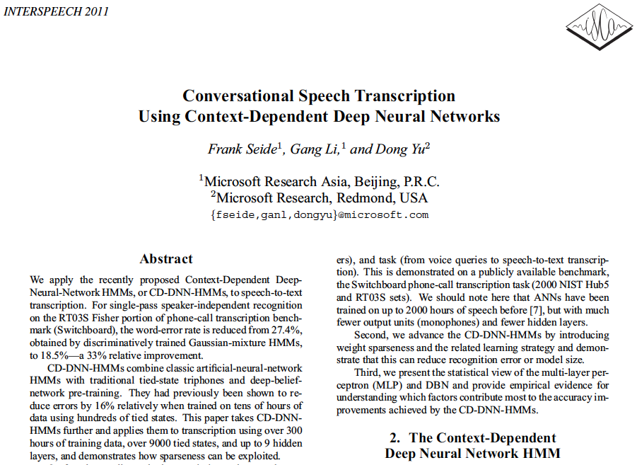
Deep Neural Networks for STT

Slide 8
DNN Acoustic Models for the Masses
Nontrivial to get the DNN models to work well
Design decisions: # layers, # nodes, # outputs, type of nonlinearity, training criterion
Training art: learning rates, regularization, update stability (max change), data randomization, # epochs
Computational art: matrix libraries, memory mgmt
Kaldi recipes provide a robust starting point
Corpus | Training Speech | SGMM WER | DNN WER
BABEL Pashto | 10 hours | 69.2% | 67.6%
BABEL Pashto | 80 hours | 50.2% | 42.3%
Fisher English | 2000 hours | 15.4% | 10.3%

Slide 9
Talk Outline: Staying Ahead in the STT Game
STT technology is advancing very rapidly
Amazon, Apple, Baidu, Facebook, Google, Microsoft
Kaldi leads and keeps up with major innovations
From SGMMs to DNN (2012)
From “English” to low-resource languages (2013)
From CPUs to GPUs (2014)
From close-talking to far-field microphones (2015)
From well-curated to “wild type” corpora (2016)
A preview of some upcoming developments

Slide 10
STT in Low-Resource Languages
NIST TREC SDR (1998)
Spoken “document” retrieval from STT output as good as retrieval from reference transcripts
Speech search was declared to be a “solved” problem
NIST STD Pilot (2006)
STT was found to be inadequate for spoken “term” detection in conversational telephone speech
Limited language diversity in available CTS corpora
English Switchboard, Call Home and Fisher
Arabic and Mandarin Chinese Call Home
IARPA Babel (2012)
Focused on IC priorities: data, methods, metrics
Limited & realistic data, many languages, keyword search

Slide 11
Low-Resource STT for the Masses
Kaldi provides language-independent recipes
Typical BABEL Full LP condition
80 hours of transcribed speech, 800K words of LM text, 20K word pronunciation lexicon
Typical BABEL Limited LP condition
10 hours of transcribed speech, 100K words of LM text, 6K word pronunciation lexicon
Language | Cantonese |  | Tagalog |  | Pashto |  | Turkish
Speech | 80h | 10h | 80h | 10h | 80h | 10h | 80h | 10h
CER/WER | 48.5% | 61.2% | 46.3% | 61.9% | 50.7% | 63.0% | 51.3% | 65.3%
ATWV | 0.47 | 0.26 | 0.56 | 0.28 | 0.46 | 0.25 | 0.52 | 0.25

Slide 12
Talk Outline: Staying Ahead in the STT Game
STT technology is advancing very rapidly
Amazon, Apple, Baidu, Facebook, Google, Microsoft
Kaldi leads and keeps up with major innovations
From SGMMs to DNN (2012)
From “English” to low-resource languages (2013)
From CPUs to GPUs (2014)
From close-talking to far-field microphones (2015)
From well-curated to “wild type” corpora (2016)
A preview of some upcoming developments

Slide 13
Parallel (GPU-based) Training
Original neural network training algorithms were inherently sequential (e.g. SGD)
Scaling up to “big data” becomes a challenge
Several solutions have emerged recently
2009: Delayed SGD (Yahoo!)
2011: Lock-free SGD (Hogwild! U Wisconsin)
2012: Gradient averaging (DistBelief, Google)
2014: Model averaging (NG-SGD, Kaldi)

Slide 14
Model Averaging with NG-SGD (Natural Gradient Stochastic Gradient Descent)
Train DNNs with large amount of data
Utilize a cluster of CPUs or GPUs
Minimize network traffic (esp. for CPUs)
Solution: exploit data parallelization
Update model in parallel over many mini-batches
Infrequently average models (parameters)
Use “Natural-Gradient” SGD for model updating
Approximates conditioning via inverse Fisher matrix
Improves convergence even without parallelization

Slide 15
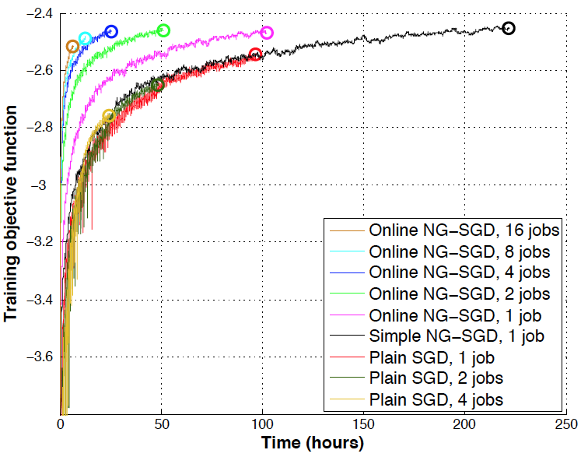
Parallelization Matters!
Typically, a GPU is 10x faster than a 16 core CPU
Linear speed-up till ca 4 GPUs, then diminishing

Slide 16
Talk Outline: Staying Ahead in the STT Game
STT technology is advancing very rapidly
Amazon, Apple, Baidu, Facebook, Google, Microsoft
Kaldi leads and keeps up with major innovations
From SGMMs to DNN (2012)
From “English” to low-resource languages (2013)
From CPUs to GPUs (2014)
From close-talking to far-field microphones (2015)
From well-curated to “wild type” corpora (2016)
A preview of some upcoming developments

Slide 17
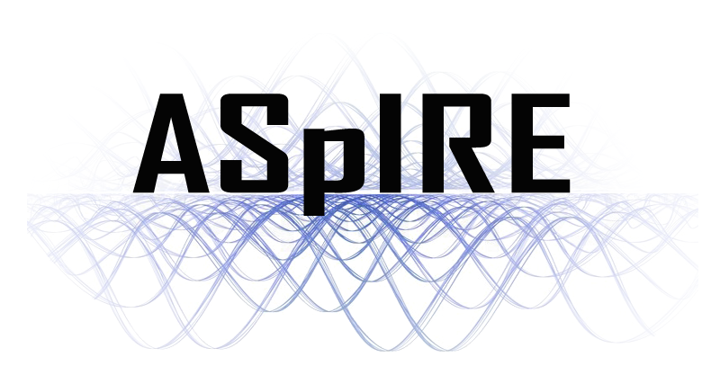
Automatic speech recognition software that works in a variety of acoustic environments and recording scenarios is a holy grail of the speech research community.
IARPA’s Automatic Speech recognition In Reverberant Environments (ASpIRE) Challenge is seeking that grail.

Slide 18
Rules of the ASpIRE Challenge
15 hours of speech data were posted on the IARPA website
Multi-microphone recordings of conversational English
5h development set (dev), 10h development-test set (dev-test)
Transcriptions provided for dev, only scoring for dev-test output
For training data selection, system development and tuning
20 hours of new speech data during the evaluation period
Far-field microphone speech (eval) from noisy, reverberant rooms
Single-microphone or multi-microphone conditions
Word error rate is the measure of performance
Single-microphone submissions were due on 02/18/2015
Results on eval were announced as of 04/14/2015
dev-test scores suggest we have the best single STT system

Slide 19

Examples of ASpIRE Audio
Typical sample
Suggested by Dr. Mary Harper, IARPA
Almost manageable
Easy for humans, 26% errors for STT
Somewhat hard
Easy for humans, 41% errors for STT
Much harder
Not easy for humans, 60% errors for STT
*#@! !#% #%^^
Very hard for humans, no STT output

Slide 20
Kaldi STT Improvements for ASpIRE
Time delay neural networks (TDNN)
A way to deal with long acoustic-phonetic context
A simple alternative to Deep NNs and Recurrent NNs
i-vector based speaker & environment adaptation
A way to deal with speaker & channel variability
Adapted [with a twist] from Speaker ID systems
Data augmentation with simulated reverberations
A way to mitigate channel distortions not seen in training
A form of multi-condition training of STT models

Slide 21
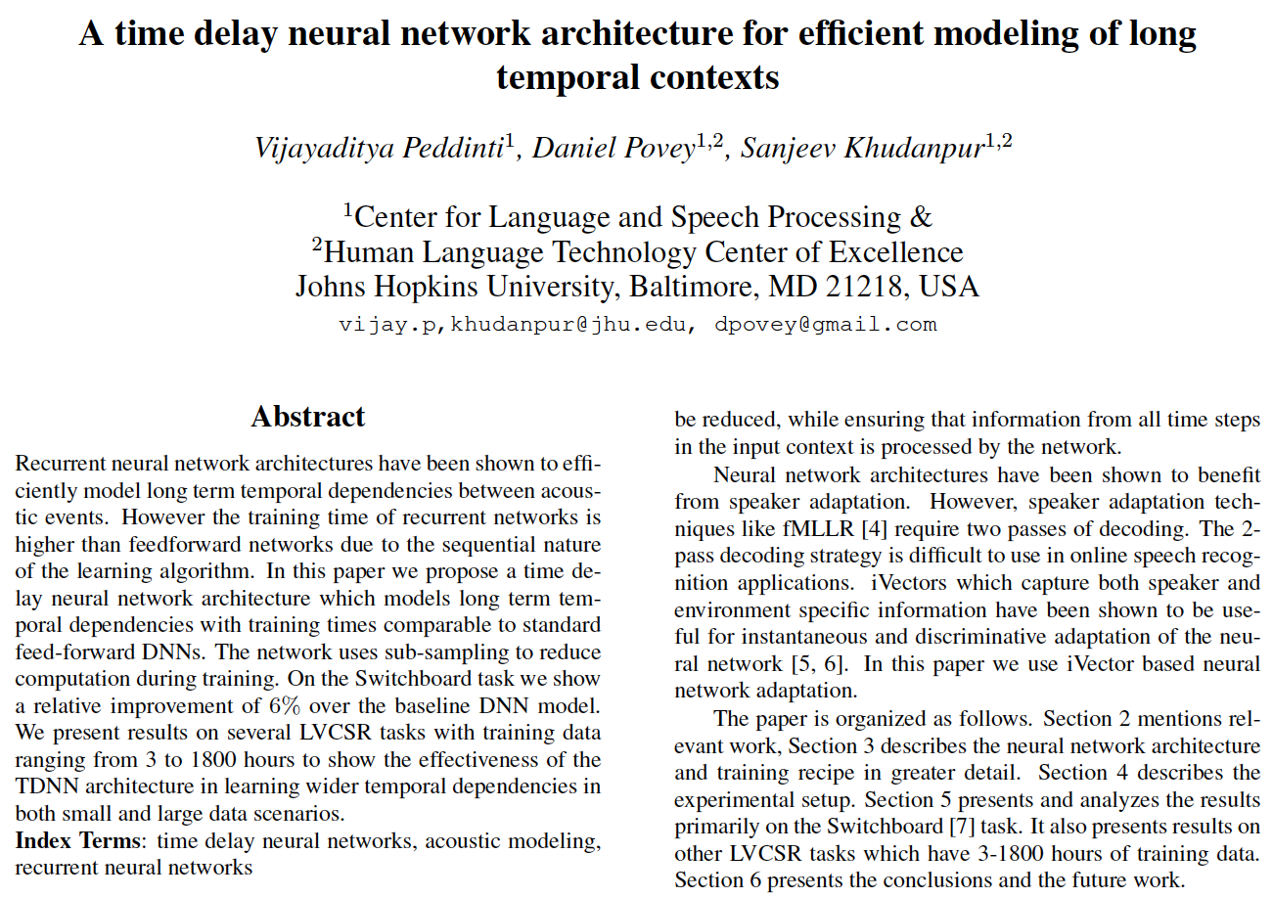
Time Delay Neural Networks (See INTERSPEECH 2015 paper for details)

Slide 22
Improved STT on Several Data Sets
Standard STT Data Set | Size | DNN | TDNN | Rel. Δ
Resource Management | 3 hrs | 2.3% | 2.3% | -1%
Wall Street Journal | 80 hrs | 6.6% | 6.2% | 5%
TED-LIUM | 118 hrs | 19.3% | 17.9% | 7%
Switchboard | 300 hrs | 15.5% | 14.0% | 10%
Libri Speech | 960 hrs | 5.2% | 4.8% | 7%
Fisher English | 1800 hrs | 22.2% | 21.0% | 5%
Consistent 5-10% reduction in word error rate (WER) on most datasets. Higher on conversational speech.
TDNN training speeds are on par with DNN, and nearly an order of magnitude faster than RNN

Slide 23
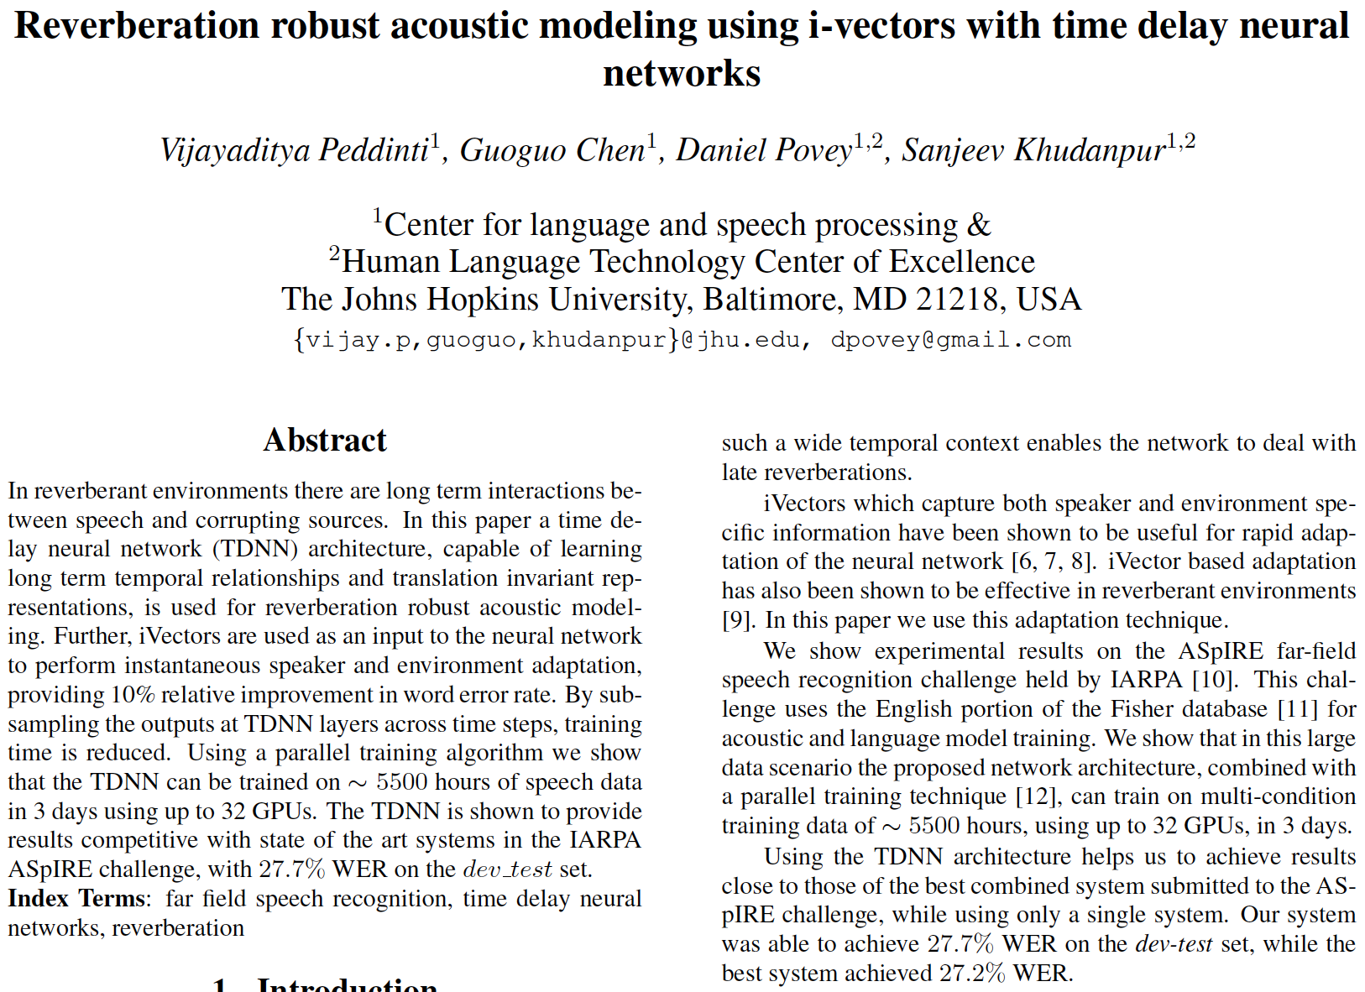
i-vectors for Speaker Compensation (See INTERSPEECH 2015 paper for details)

Slide 24
Using i-vectors Instead of fMLLR and using unnormalized MFCCs to compute i-vectors
100-dim i-vectors are appended to MFCC inputs of the TDNN
i-vectors are computed from raw MFCCs (i.e. no mean normalization)
UBM posteriors however use MFCCs normalized over a 6 sec window
i-vectors are computed for each training utterance
Increases speaker- and channel variability seen in training data
May model transient distortions? e.g. moving speakers, passing cars
i-vectors are calculated for every ca 60 sec of test audio
UBM prior is weighted 10:1 to prevent overcompensation
Weight of test statistics is capped at 75:1 relative to UBM statistics
Speaker Compensation Method | WER
TDNN without i-vectors | 34.8%
+ i-vectors (from all frames) | 33.8%
+ i-vectors (from reliable speech frames) | 30.8%

Slide 25
Training with Simulated Reverberation (See INTERSPEECH 2015 paper for details)

Slide 26
Result of Data Augmentation
Acoustic Model | Data Augmentation | Dev WER
TDNN A (230 ms) | None (1800h, clean speech) | 47.6%
TDNN A (230 ms) | + reverberation + noise + 3x | 31.7%
TDNN B (290 ms) | + reverberation + noise + 3x | 30.8%
TDNN A (230 ms) | + sampling rate perturbation | 31.0%
TDNN B (290 ms) | + sampling rate perturbation | 31.1%
Data augmentation with simulated reverberation is beneficial
Likely to be a very important reason for relatively good performance
Sampling rate perturbation helps very little on ASpIRE
Sequence training helped reduce WER on the dev set but the gains did not carry over to dev-test
Required modifying the sMBR training criterion to realize gains

Slide 27
The IARPA ASpIRE Challenge Winners
Participant | Test WER | System Type
BBN | 44.3% | Combination
Kaldi | 44.3% | Single System
Singapore | 44.8% | Combination

Slide 28
Talk Outline: Staying Ahead in the STT Game
STT technology is advancing very rapidly
Amazon, Apple, Baidu, Facebook, Google, Microsoft
Kaldi leads and keeps up with major innovations
From SGMMs to DNN (2012)
From “English” to low-resource languages (2013)
From CPUs to GPUs (2014)
From close-talking to far-field microphones (2015)
From well-curated to “wild type” corpora (2016)
A preview of some upcoming developments

Slide 29
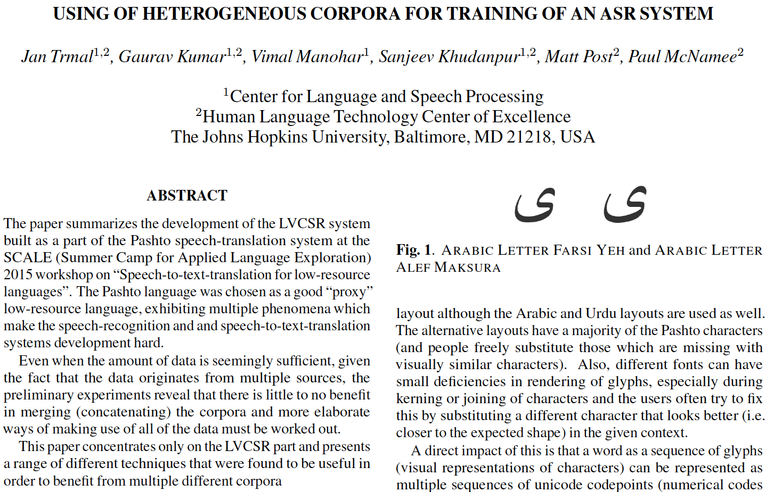
A Study in Pashto (See our manuscript declined by INTERSPEECH 2016)

Slide 30
A Study in Pashto
Transcriptions require extensive cross-corpus normalization
Even after that, language models don’t benefit much from corpus pooling
Simple corpus pooling doesn’t improve acoustic modeling either
DNNs with shared “inner” layers and corpus-specific input and output layers work best
Training Data | Single Model | Interpolation Weights LM A LM B LM T |  |  | Interpolated Model
Text A | 99.2 | 0.8 | 0.2 | 0.0 | 92.9
Text B | 141.9 | 0.1 | 0.8 | 0.1 | 140.0
Text T | 86.7 | 0.0 | 0.0 | 1.0 | 86.7
DNN Training Data | STT Word Error Rates Test A Test B Test T
Single corpus (matched) | 55.4% | 46.8% | 24.8%
Two corpora (Pashto A + B) | 51.9% | 48.2% | 52.6%
Multi-corpus (A+B) Training Strategy | STT Word Error Rates Test A Test B Test T
Shared DNN layers (except 1) | 53.2% | 47.4% | 27.0%
Shared DNN layers (except 2) | 51.2% | 45.0% | 25.4%
+ Optimized Language Model | 50.8% | 44.8% | 25.4%
+ Duration Modeling | 50.4% | 44.3% | 24.8%

Slide 31
Talk Outline: Staying Ahead in the STT Game
STT technology is advancing very rapidly
Amazon, Apple, Baidu, Facebook, Google, Microsoft
Kaldi leads and keeps up with major innovations
From SGMMs to DNN (2012)
From “English” to low-resource languages (2013)
From CPUs to GPUs (2014)
From close-talking to far-field microphones (2015)
From well-curated to “wild type” corpora (2016)
A preview of some upcoming developments

Slide 32
Other Additions and Innovations
Multilingual acoustic model training
Using other-language speech to augment a limited transcribed speech corpus
Removing reliance on pronunciation lexicons
Grapheme based models and acoustically aided G2P
Diarization (including speech activity detection)
Segmenting long speech recording to determine “who spoken when, and in which language”
Chain models
10% more accurate STT, plus
3x faster decoding, and 5x-10x faster training

Slide 33
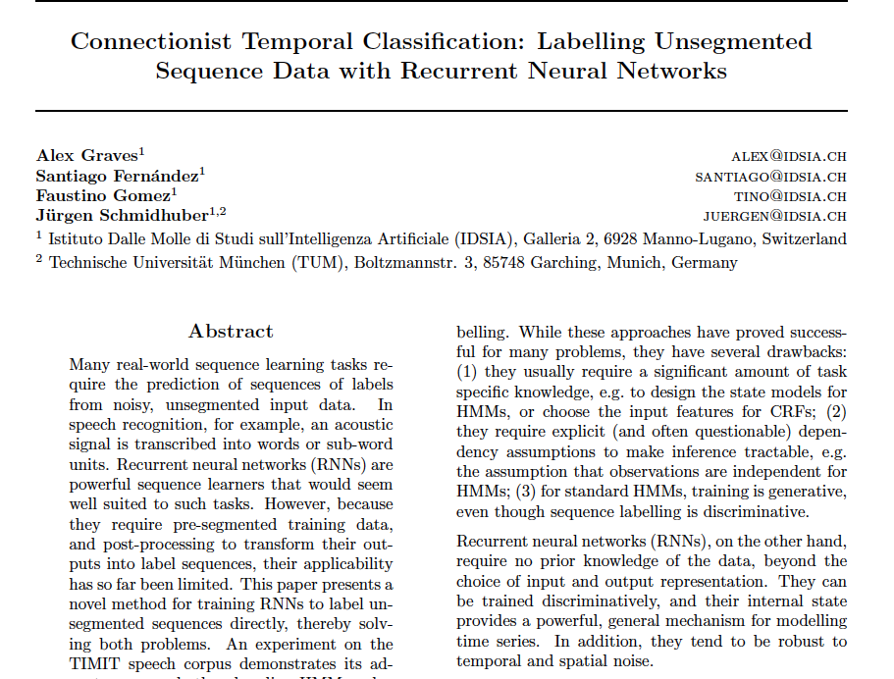
2006: A New Kid on the NNet Block

Slide 34
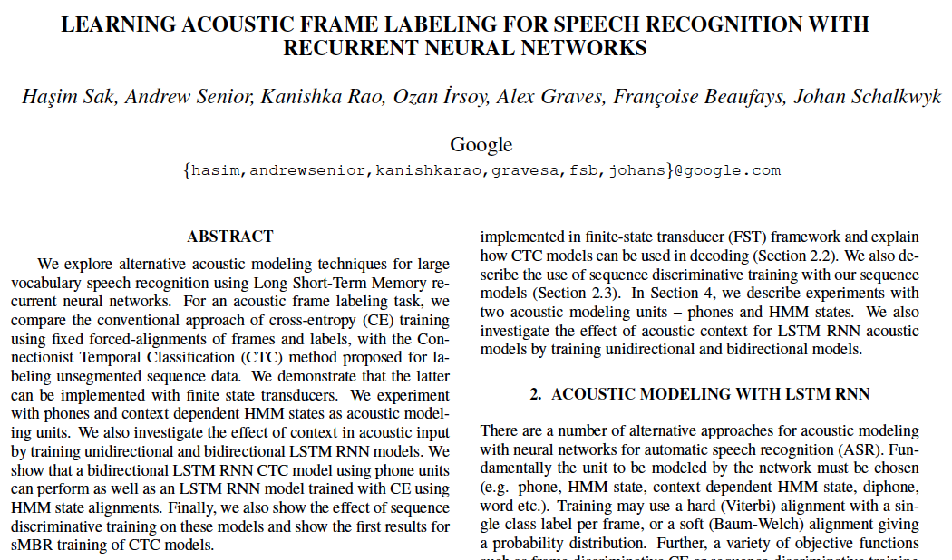
2015: The New Kid Comes of Age

Slide 35
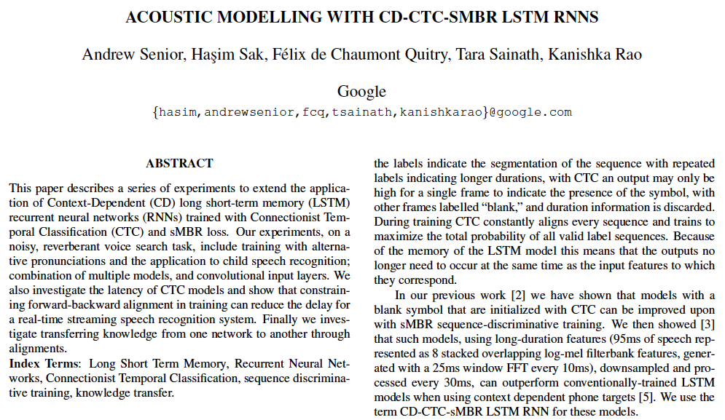
2015: The New Kid Comes of Age

Slide 36
First, the Bad News …
We haven’t been able to get CTC models to give us any noticeable improvement over our best (TDNN or LSTM-RNN) models on our data
It appears to be easier to get them to work when one has several 1000 hours of labeled speech
But we care about lower-resource scenarios

Slide 37
… and then the Good News
We are able to get similar improvements using a different model, which is inspired by ideas from the CTC papers
Use simple “1-state” HMMs for each CD phone
Reduce frame rate from 100 Hz to 33 Hz
Permit slack in the frame-to-state alignment
A new lattice-free MMI training method
Improved parallelization, sequence training on GPUs
Larger mini-batches, smaller I/O bandwidth
Does not require CE training before MMI training
Uses “flexible label alignment” inspired by CTC

Slide 38
Chain Models and LF-MMI Training STT Performance on a Variety of Corpora
Corpus and Audio Type | Training Speech | CE + sMBR Error Rate | LF-MMI Error Rate
AMI IHM | 80 hours | 23.8% | 22.4%
AMI SDM | 80 hours | 48.9% | 46.1%
TED-LIUM | 118 hours | 11.3% | 12.8%
Switchboard | 300 hours | 16.9% | 15.5%
Fisher + SWBD | 2100 hours | 15.0% | 13.3%
Chain models with LF-MMI reduce WER by 6%-11% (relative)
LF-MMI improves a bit further with additional sMBR training
FL-MMI is 5x-10x faster to train, 3x faster to decode

Slide 39
Talk Summary: Staying Ahead in the STT Game
STT technology is advancing very rapidly
Amazon, Apple, Baidu, Facebook, Google, Microsoft
Kaldi leads and keeps up with major innovations
From SGMMs to DNN (2012)
From “English” to low-resource languages (2013)
From CPUs to GPUs (2014)
From close-talking to far-field microphones (2015)
From well-curated to “wild type” corpora (2016)
Chain models for better STT, faster decoding (2017)
and the list goes on ...

Slide 40
Acknowledgements Again!
Prof. Daniel Povey
Dr. Jan Trmal
Pegah Ghahremani
Vimal Manohar
Vijayaditya Peddinti
Matthew Wiesner
Hainan Xu
Xiaohui Zhang

Slide 41
Kaldi Points-of-Contact
Dr. Sanjeev Khudanpur
khudanpur@jhu.edu
410-516-7024
SID: spkhuda
Dr. Daniel Povey
povey@gmail.com
Dr. Jan “Yenda” Trmal
trmal@jhu.edu

